Slide 1



Department of Electronics and Communication Engineering
Codegene-Skill Enhancement Course
EMPLOYEE ATTENDANCE TRACKER PROJECT PRESENTATION
NAME:SHAIK.MUKEETH
REG NO:43130721
SECTION:C2
SEM/YEAR:5th SEM/3RD YEAR

Slide 2
Abstract
The Employee Attendance Tracker is a web-based system for tracking employees’ daily attendance efficiently.
It replaces the traditional manual attendance process with a modern digital interface.
The system helps organizations maintain accurate and up-to-date attendance records.
It enables administrators to add, view, and manage employee attendance seamlessly.
The application ensures secure data management using a centralized database.
Attendance records can be generated and reviewed anytime from any location.
It reduces human effort by automating repetitive attendance-related tasks.
The system is user-friendly and accessible through any web browser.
Reports can be generated automatically without manual calculations.

Slide 3
Existing System
In the existing system, attendance is recorded manually in registers or spreadsheets.
The process is time-consuming and prone to human errors.Manual systems lack the ability to generate instant attendance reports.
Storing and maintaining records physically occupies space and effort.
Searching for past attendance data is difficult and inefficient.
Employees’ data can easily be lost or mismanaged in manual methods.
Updating attendance information requires rewriting or re-entry.
Communication between HR and employees regarding attendance is slow.
Data security is low since registers can be misplaced or damaged.
Overall, manual attendance tracking reduces productivity and accuracy.

Slide 4
Proposed System
The proposed system is a full-stack web application for managing attendance online.
It allows both admin and employees to interact with attendance records digitally.
Attendance can be marked easily with a single click.The system automatically
stores attendance data in a MySQL database.Admin can view daily, weekly, and monthly attendance reports instantly.
The application ensures role-based authentication for data security.
It eliminates paperwork and provides real-time updates.
Reports can be downloaded or viewed anytime from the admin dashboard.
The system supports scalability for future enhancements.
Overall, it saves time, improves accuracy, and ensures secure data handling.

Slide 5
Advantages
Reduces manual work and human errors in attendance marking.Provides instant access to employee attendance records.
Ensures high accuracy and reliability in data storage.
Centralized system for easy management by HR or admin.
Generates attendance reports quickly and automatically.
Saves paper and reduces operational costs.
Enhances productivity by automating daily attendance tasks.
Secure login prevents unauthorized data access.
Easy to integrate with payroll or HR management systems.
Accessible from any device through a web browser.

Slide 6
Disadvantages
Requires an active internet connection for real-time access.Initial setup needs technical configuration.
Data loss may occur if the database is not backed up regularly.
System maintenance is required periodically.Only authorized users can access — others need permissions.
Depends on server uptime and hosting quality.
If not optimized, large data sets may slow performance.
UI may require training for first-time users.
Vulnerable to security threats without proper protection.
Costs may increase if cloud hosting or premium services are used.

Slide 7
Hardware Requirements
Processor: Intel i3 or higher recommended for smooth performance.
RAM: Minimum 4GB to run backend and frontend efficiently.
Hard Disk: At least 500GB for storage and database files.
Display: 1024x768 or higher resolution screen.
Keyboard and Mouse for user input and navigation.
Reliable internet connection for online operations.
System should support modern browsers like Chrome or Edge.
A UPS is recommended to prevent data loss during power failure.
Server or local host computer to deploy backend.
External storage for data backup purposes.

Slide 8
Software Requirements
Operating System: Windows / Linux / macOS supported.
Programming Language: Java for backend logic.
Framework: Spring Boot for server-side development.
Frontend: HTML, CSS, JavaScript for UI design.
Database: MySQL for data storage.
IDE: IntelliJ IDEA / Eclipse for Java development.
Web Server: Apache Tomcat for hosting backend.
GitHub for version control and project hosting.
Browser: Google Chrome for running the web app.
Online Compiler: Replit or CodeChef for demonstration.

Slide 9
Modules
Login Module – Handles user authentication securely.
Employee Module – Stores and manages employee data.
Attendance Module – Allows marking and tracking daily attendance.
Dashboard Module – Displays key attendance statistics.
Report Module – Generates detailed attendance summaries.
Database Module – Stores all data persistently.
Admin Module – Provides admin-level control and management.
Notification Module – Sends alerts or reminders for attendance.
Search Module – Enables quick lookup of employee data.
Export Module – Allows exporting reports as Excel or PDF files.

Slide 10
Module Description
Login Module: Secure login using username and password validation.
Employee Module: Admin can add, edit, or remove employee details.
Attendance Module: Tracks employee presence or absence daily.
Dashboard Module: Displays graphical data on attendance trends.
Report Module: Creates attendance summaries by date or month.
Database Module: Connects backend to MySQL for data storage.
Admin Module: Manages system users and access levels.
Notification Module: Alerts users about missing attendance.
Search Module: Allows filtering attendance by employee or date.
Export Module: Lets admin download reports for record keeping.

Slide 11
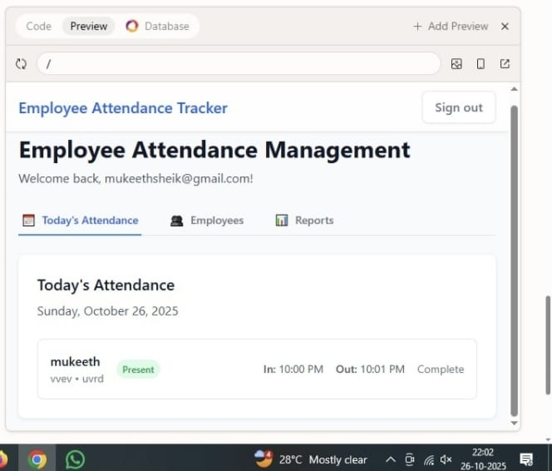
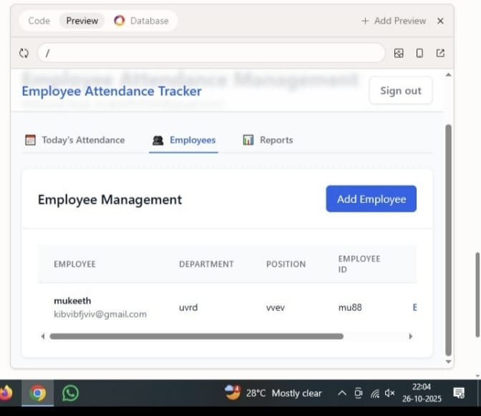
Sample Output
Attendance check
Adding Employees

Slide 12
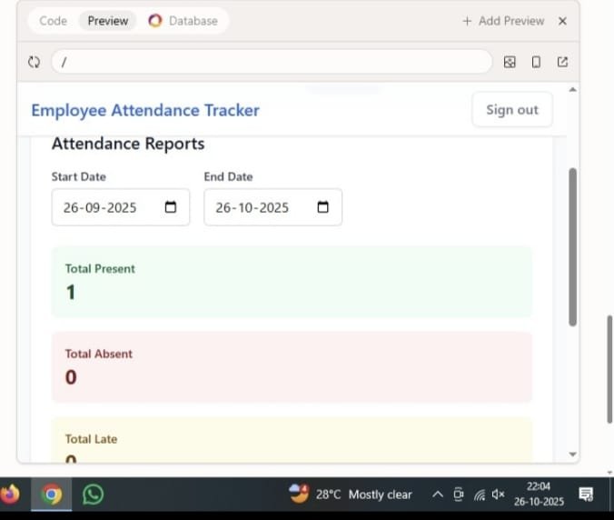
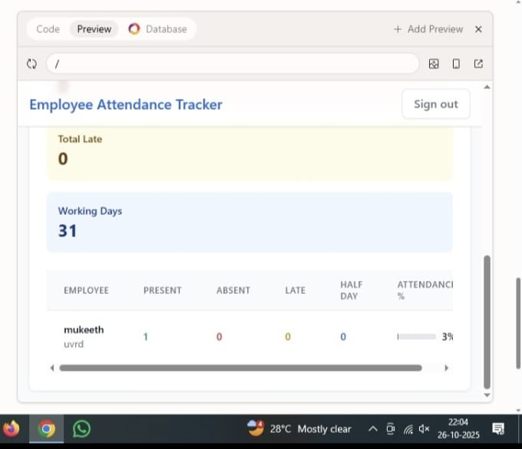
Marking attendance
Overall attendance checking

Slide 13
Conclusion
The Employee Attendance Tracker successfully automates manual attendance management into a digital web system.
It helps organizations save time and reduce errors while maintaining accurate employee data.
The integration of Java Spring Boot and MySQL ensures fast, secure, and reliable backend performance.
This combination enhances data consistency and allows smooth database connectivity.
The user interface built with HTML, CSS, and JavaScript provides a simple and interactive experience.
It enables even non-technical users to mark and view attendance easily.
The system ensures transparency and accountability in employee attendance.
Each record is stored securely and can be retrieved or verified anytime.

Slide 14

.

